Slide 1

Coroutine/Continuation
Dudi Likvornik
2018

Slide 2




The story of continuation
Say you're in the kitchen in front of the refrigerator, thinking about a sandwich. You take a continuation right there and stick it in your pocket. Then you get some turkey and bread out of the refrigerator and make yourself a sandwich, which is now sitting on the counter. You invoke the continuation in your pocket, and you find yourself standing in front of the refrigerator again, thinking about a sandwich. But fortunately, there's a sandwich on the counter, and all the materials used to make it are gone. So you eat it.

Slide 3

Coroutine - Concept
A type of control flow.
Was invented in the 60s.
Was neglected by most main stream languages except of – Simula, BCPL, Icon, Modula2
So what is coroutine in general?
Most programmers love procedural code:
eip
eip
eip
b = 0
b = 1
eip
Frame 2
eip
Frame 1

Slide 4
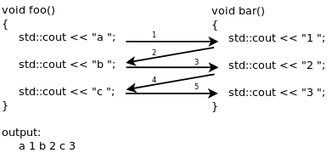
Coroutine - Concept
Main attributes of procedural code:
Very easy to understand and to track its flow.
All functions (for example in C++/C) are stateless – once over, all automatic/local variables are destroyed along with the stack frame.
Functions in some languages (for example C++/C) are second class citizens – its not possible to provide them as arguments, return as result value, kept as a state of other object by value or reference.
Coroutine can be viewed as a generalized function which may suspend and resume, which provides a new kind of control flow.
foo and bar alternates their operations (suspend and resume).

Slide 5
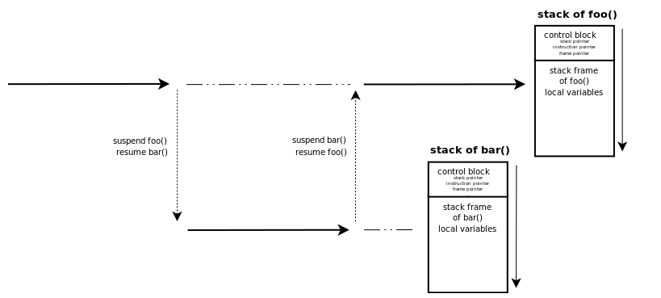
Coroutine - Concept
Control transfer mechanism:
Symmetric – symmetric coroutines transfer their control using a single operator. One coroutine suspend (and save its state) while a second resumes and restores its state.
The yield operator needs to be specified which coroutine its going to yield control to.

Slide 6
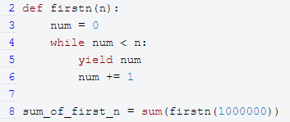
Coroutine - Concept
Control transfer mechanism:
Asymmetric coroutine – The coroutine supports two forms of operators:
A function with suspend operator.
A function with resume operator.
For example – python generators:
Generators are stackless-asymetric-coroutines (more on that in the next slide).
Act as first class citizen (as of all functions in the language).
__next__ operator – invokes the coroutine resume action.
yield - a special token marking the suspend for the interpreter.
In both control transfer mechanism state of automatic variables is kept between Suspend/Resume.

Slide 7
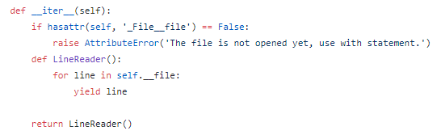
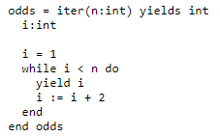

Coroutine - Concept
First class citizen vs constrained
First class citizen – the coroutine act as an object, can be passed as an argument, return value or state of other object according to the data model rules of the language.
Good example – python coroutines:
Invocation of LineReader() will create a new generator instance, its reference is returned.
Just to be clear, all compositions relations and transfer in python are reference based, so this is legit (unlike in C++, where function will not support by value or reference relations).
Constrained – the coroutine is not passable, for example – CLU language iterator which only exists in the scope of the range.

Slide 8
Coroutine - Concept
Stackfulness vs Stackless
Stackfulness – it is possible to suspend the coroutine execution from with a set of nested functions.
The next time the coroutine will resume, it will retain its nested location.
Stackless – it is possible to suspend the coroutine execution from a single stack frame. It can only retain its operation to that frame.
Python generators a stackless.
The yield token frame location represent the coroutine stack frame.
Coroutine stack frame

Slide 9
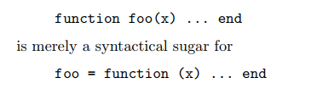
LUA overview
Lua is a light-weight language that supports general procedural programming with data description facilities.
It is dynamically typed, lexically scoped, and has automatic memory management.
Lua supports eight basic value types: nil, boolean, number, string, userdata, thread, function, and table.
Functions in Lua are first-class values: they can be stored in variables, passed as arguments to other functions, and returned as results. Lua functions are always anonymous; the syntax:
Tables in Lua are associative arrays and can be indexed with any value.
Supports traditional control structures – (if, while, repeat and for).

Slide 10
Coroutine - Operators
The base case for all upcoming coroutines are asymmetric coroutines.
We will define 3 types of special operators:
Create – creates a new coroutine.
it receives a procedural argument (representing the user logic) and returns a reference to the created coroutine.
Creating a coroutine does not start its execution; a new coroutine begins in suspended state with its continuation point set to the first statement in its main body.
Resume – re(activate) a coroutine.
It receives as its first argument a coroutine reference, returned from a previous create operation.
Once resumed, a coroutine starts executing at its saved continuation point and runs until it suspends or its main function terminates.
Yield – suspends the coroutine execution.
The coroutine’s continuation point is saved so that the next time the coroutine is resumed, its execution will continue from the exact point where it suspended.

Slide 11
Lua Coroutine library
Lua provides a coroutine library.
Library supports all depicted coroutine operators.
For example – cotoutine.create:
Creates a new coroutine instance.
The coroutine is allocated with its unique stack.
A function is provided as an argument.
LUA also supports – cotoutine.wrap:
Equivalent for create, but will only return a function which wraps a coroutine, upon invocation will resume the coroutine.
coroutine.yield:
Same as the yield operator, lua supports multiple return values (like in python), which may be returned with yield.
coroutine.resume/wrapper function call:
Same as resume operator, may provide multiple arguments back to the invocation point.

Slide 12
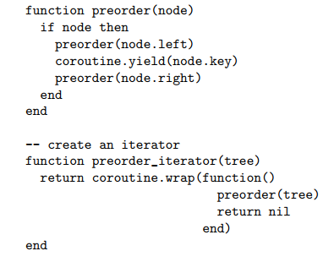
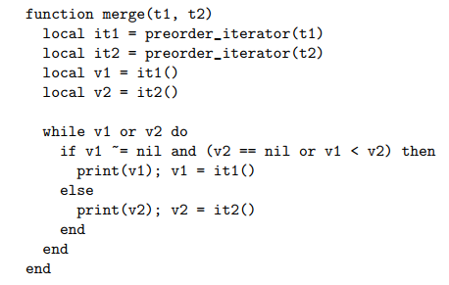
Example 1 - stackfull-asymetric coroutine example
Pre order merge of two binary trees in sorted manner.
Preorder suspends and returns the value of the current tree node.
Iterator creates a coroutine which starts its pre order search from the tree root.
Both trees are traversed using the coroutine. Each coroutine acts with its own stack recursively, but the operation seems to be iterative in its programming manner.

Slide 13
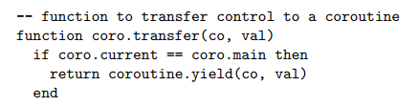
Example 2 - stackfull-symetric coroutine example
A concurrency engine is built using coroutine.
Symmetric coroutines supports one kind of control which yields control between two coroutines.
No preemption is supported. Transfer needs to be made explicitly by the user.
The following example uses asymmetric coroutines in order to produce symmetric coroutines.
Transfer is a new function (the symmetric coroutine operator in our example) in charge on transferring control between two coroutines, suspending one and resuming the other:

Slide 14
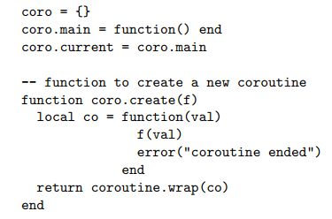
Example 2 - stackfull-symetric coroutine example
Create – receives a user function.
A function wrapper receives a single parameter, which will forwarded to the user function.
The function wrapper adds the functionality of an error in case the asymmetric coroutine will not yield its control (we want to enforce the behavior of symmetric coroutine).
The wrapper is provided to a newly created coroutine.

Slide 15
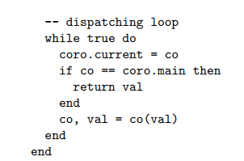
Example 2 - stackfull-symetric coroutine example
The dispatching loop:
Each coroutine uses the transfer function to yield control.
Transfer returns a logical mid value (from the last computation) and the new coroutine to transfer control to.
The received value will be provided as an argument to the dispatched coroutine.
If the new corouine is the main one, the value is returned as the final result.

Slide 16
Continuation - Concept
A continuation represent the rest of computation from a given point in the computation.
Usually Continuations are provided as first class citizens.
Usually continuation are invoked only once (suspend and resume) and for that a special operator is created – call/1cc.
call/1cc will create a continuation for the current computation, will transfer the control to some other computation, which in turn will resume the previous computation.
Lets implement the special call/1cc operator using our symmetric coroutines from previous example.

Slide 17
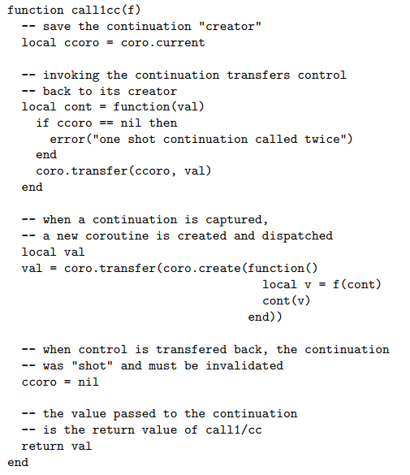
Continuation - Concept
The current coroutine calls call1cc (which mark
A pause in the current computation).
The current coroutine is our continuation of
To be replaced current computation flow.
cont function represents our resume operator
of our saved continuation (passed as first class
citizen to the function).

Slide 18
Continuation - Concept
The control is transferred to some other
computation by using a coroutine.
The new computation is provided with the
previously created continuation and its resume
function.
Once resumed, the continuation resumes
to the marked point of computation and
marked with nill as used (one shot).

Slide 19
Continuation vs Coroutine
Suspend:
Coroutines suspends up stack.
Continuations suspends down stack.
Stackfull coroutine keep a partial state of the stack, from its frame of creation till suspension.
Non partial continuations keeps the entire stack as their state.
Frame 1
Frame 2
Frame 3
Frame 1
Frame 2
Frame 3

Slide 20
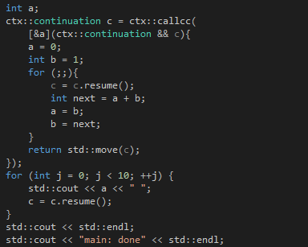
Boost – Continuation
Continuation example using boost:
output: 0 1 1 2 3 5 8 13 21 34

Slide 21

Boost Fiber
Fiber is boost user space thread library (available since last year boost 1.62).
Built on top kernel threads and provides hybrid thread N:M implementation (BSD did that first, so what).
Provides same functionality as kernel threads to the user, along with synchronization elements:
yield()
detach()
join()
mutex
conditional_variable
barrier
promise, future, tasks
Supports user defined scheduler.
Each fiber comes with its own stack.
Context switch is based on continuations.

Slide 22
Boost Fiber – context switch
Each fiber continuation object == its private stack.
Continuation object
Continuation object
Fiber B
Fiber A
Fiber B State
Fiber A
State
Fiber A
Context switch
Fiber B

Slide 23

Boost Fiber – Continuation Object (at creation of fiber)
Continuation object layout:
+00h
CPU mmx state
+04h
CPU x87 control word
+08h
Fiber storage
Stack frames
+0Ch
Dellocation stack (low address)
+10h
Stack limit (low address)
+14h
Stack base (high address)
+18h
Fiber SEH exception list
Continuation context data
+1Ch-23h
Empty/EDI/ESI
+24h
Context function/EBX
List only contains a single instance at fiber creation
+28h
Finish function/EBP
+2Ch
Trampoline function/EIP
+30h
Empty/Future continuation argument
+34h
Empty/Future record argument
Fiber SEH Object == Equivalent to windows one
+38h
Next = 0xffffffffff
+3Ch
Windows SEH handler

Slide 24
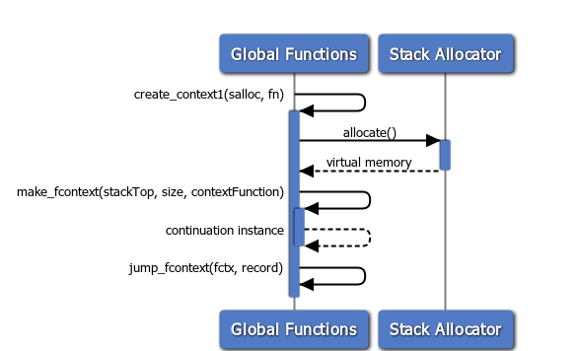
Boost Fiber – Fiber creation
Virtual memory is allocated for the continuation object using an allocator.
The continuation object is built on top of that memory.
A context switch between the current fiber and the new one is commenced.

Slide 25
Boost Fiber – Fiber context switch (Windows)
Current Fiber holds its state with in the current thread TEB:
+00h
SEH list first element
EDI
+04h
Stack base (high address)
ESI
+08h
Stack limit (low address)
FS
EBX
+10h
Fiber data
EBP
+E0Ch
Dellocation stack (low address)
FS + 18h == linear address of TEB in virtual memory
EBP hold address == current frame start address, [EBP]== previous EBP address

Slide 26
Boost Fiber – Fiber context switch
+00h
CPU mmx state
+04h
CPU x87 control word
Current fiber transition from TEB to continuation on stack (Suspend)
+08h
Fiber storage
MMX state
+00h
SEH list first element
+0Ch
Dellocation stack (low address)
+04h
Stack base (high address)
+10h
Stack limit (low address)
+08h
Stack limit (low address)
+14h
Stack base (high address)
X87 CW
+10h
Fiber data
+E0Ch
Dellocation stack (low address)
+18h
Fiber SEH exception list
Transfer state
+1Ch
EDI
EDI
ESI
+20h
ESI
EBX
+24h
Context function/EBX
EBP
To be constructed Continuation context data
+28h
EBP
Stack frames
+2Ch
EIP
+30h
continuation argument (of previous Fiber)
+34h
record argument (of next Fiber)
Points to previous Continuation
Continuation context data
EAX

Slide 27
Boost Fiber – Fiber context switch (Windows)
EDI
X87 CW
MMX state
New fiber from continuation on stack to TEB (Resume)
ESI
+00h
CPU mmx state
EBX
EBP
+04h
CPU x87 control word
+00h
SEH list first element
+08h
Fiber storage
+04h
Stack base (high address)
+0Ch
Dellocation stack (low address)
+08h
Stack limit (low address)
Transfer state
+10h
Stack limit (low address)
+10h
Fiber data
+E0Ch
Dellocation stack (low address)
+14h
Stack base (high address)
+18h
Fiber SEH exception list
ECX
+1Ch
Empty/EDI
ECX acts as EIP
+20h
Empty/ESI
Continuation context data constructed in the past
+24h
Context function/EBX
+28h
Finish/EBP
+2Ch
Trampoline/EIP
+30h
continuation argument (of previous Fiber)
ESP
+34h
record argument (of next Fiber)

Slide 28

Boost Fiber – Fiber context switch (Windows)
Fiber continuation object have been copied to TEB and various registers.
End of context switch:
eax points to previous fiber begin of stack (his last constructed continuation object), now act as the 1st argument for the continuation trampoline function (or return value for resume).
edx points to the current fiber record instance (contains the user function to be called for the first time of the continuation run), act as 2nd argument for trampoline function, or points to nullptr for resume.
ecx points to the stop point of the current fiber (acting as eip).
Restoring the eip:

Slide 29
Boost Fiber – Fiber context switch (Windows)
Destruction of continuation object:
After context switch current fiber stack resumes from +30h (esp).
Every thing prior to +28h will be overwritten.
We used the continuation object for resume, no
further need for it.
+00h
CPU mmx state
+04h
CPU x87 control word
+08h
Fiber storage
+0Ch
Dellocation stack (low address)
+10h
Stack limit (low address)
+14h
Stack base (high address)
+18h
Fiber SEH exception list
+1Ch
Empty/EDI
+20h
Empty/ESI
+24h
Context function/EBX
+28h
Finish/EBP
+2Ch
Trampoline/EIP
esp
+30h
continuation argument (of previous Fiber)
+34h
record argument (of next Fiber)

